Slide 1
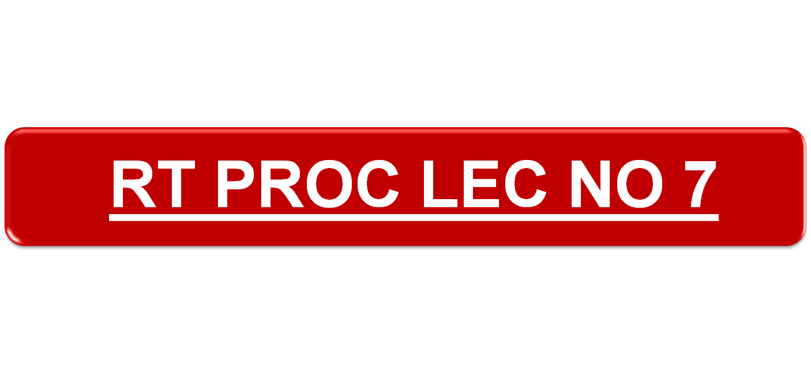

Slide 2

1. PRE-PLANNED FREQ CHANGE.
2. IMPROMPTU FREQ CHANGE.

Slide 3

1. THESE ARE LARGE SCALE PRE-ARRANGED CHANGES INTENDED TO DECEIVE THE ENEMY. SUCH CHANGES ARE ORGANISED ONLY BY THE HIGHER FMNS.
2. FULL DETAILS OF PRE-PLANNED FREQ CHANGES MUST BE NOTIFIED IN ADVANCE TO ALL CONCERNED AND MUST INCLUDE THE EXACT TIME AT WHICH THE CHANGE IS TO TAKE PLACE. WHEN EVER POSSIBLE, THIS WILL BE AT A TIME AT WHICH THE LINK SIGNS ARE CHANGED.

Slide 4
3. THE NEW FREQ MAY PREVIOUSLY BE SET UP AS A FLICK FREQ.
4. NO WARNING TXN IS MADE IN CONNECTION WITH THE PRE-PLANNED FREQ CHANGE.
5. COMNS WILL BE EST ON THE NEW FREQ USING THE NEW CODE SIGN AFTER A DELAY PD. THIS BREAK IN CONTINUITY IS HIGHLY DESIRABLE TO AVOID RECOG OF INDL NETS BY THE EN INTERCEPTION SERVICES.

Slide 5

1. ALL TRANSMISSIONS TO STOP FIVE MINUTES PRIOR TO THE INTENDED CHANGE OF FREQUENCY.
2. ALL STATIONS TO CHANGE FREQUENCY AT THE APPOINTED TIME.
3. COMMUNICATION TO BE ESTABLISHED AFTER 5 MINUTES ON HAVING CHANGED TO NEW FREQUENCY.

Slide 6
e.g. TIME FOR FREQUENCY CHANGE IS 0800H
AT 0755 - ALL TRANSMISSION STOP.
AT 0800 - CHANGE OF FREQUENCY.
AT 0805 - START COMMUNICATIONS.
AT 0815 - IF AN OUT STATION DOES NOT COME TO THE NEW FREQ THE CONTROL GOES BACK TO THE OLD FREQ , AND CALLS FOR THE PARTICULAR STATION TO FREQUENCY.

Slide 7

WHEN THE COMNS BECOME BAD DUE TO JAMMING, IMPROMPTU FREQ CHANGE IS RESORTED TO.
2. THE CONT STN TRANSMITS A PARTICULAR CODE WORD FOR A PARTICULAR FREQ ON RECEIPT OF WHICH THE NET CHANGES ONTO THAT FREQ. THIS CHANGE IS KNOWN AS IMPROMPTU FREQ CHANGE.

Slide 8
eg : F1 - 32 MHz - HEMA
F2 - 54 MHz - BARATI
+ : HULLO ALL STATIONS KKK BARATI I SAY AGAIN BARATI OVER.
KKK : HULLO KKK1 WILCO OVER.
SSS : HULLO KKK2 WILCO OVER.
TTT : HULLO KKK3 WILCO OVER.
+ : HULLO ALL STATIONS KKK BARATI NOW OUT.

Slide 9
NOTE:-
IF SAY ,AN OUTSTATION DOES NOT COME ON TO THE AIR AFTER 10 MINS THE CONTROL WILL CHANGE TO THE OLD FREQ AND ASK THAT STATION TO CHANGE FREQ.

Slide 10

NORMALLY RADIO SILENCE IS IMPOSED UNDER FWG CIRCUMSTANCES:-
TAC SITUATION.
ENTERING OR LEAVING A HARBOUR.
DURING A LONG MOVE.
IN ADVANCE TO CONTACT BEFORE CONTACT IS MADE
NOTE:-
CODE WORD FOR RADIO SILENCE WILL BE USED ONCE ONLY.

Slide 11

+ : HULLO ALL STATIONS KKK CACTUS OVER.
KKK : HULLO KKK1 WILCO OVER.
SSS : HULLO KKK2 WILCO OVER.
TTT : HULLO KKK3 WILCO OVER.
+ : HULLO ALL STATIONS KKK CACTUS NOW OUT.
NOTE:-
DURING RADIO SILENCE, NO STATION WILL MAKE ANY TRANSMISSION IN CASE OF EMERGENCY, THE STATION WILL SEND THE MESSAGE WITH SELF AUTHENCATION.

Slide 12

1. TO BREAK OR CANCEL RADIO SILENCE.
2. CRS WILL BE DUTY OF THE STN THAT IMPOSED RADIO SILENCE.
3. CODE WORD IS USED FOR CRS.

Slide 13

+ : HULLO ALL STATIONS KKK FLOWER I SAY AGAIN FLOWER REPORT MY SIGNALS OVER.
KKK : HULLO KKK1 OK OVER.
SSS : HULLO KKK2 OK OVER.
TTT : HULLO KKK3 OK OVER.
+ : HULLO ALL STATION KKK OK OUT.
NOTE:-
TO IDENTIFY ANY STATION WHILE BREAKING RADIO SILENCE, AUTHENTICATION AND CHALLENGE CAN TAKE PLACE. THIS WILL BE COVERED LATER.

Slide 14

1. WHEN CONTROL STN WANTS THAT ONLY OPERATION RELATED MSGS SHOULD BE PASSED DURING THIS TIME.
2. TO CANCEL THIS PHRASE “CANCEL MINIMISE” IS USED.

Slide 15
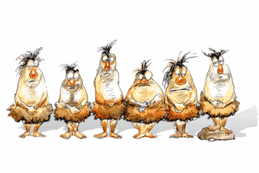
THANK YOU

